Slide 1

Introduction to Programming Lecture 01 Mr. Niaz Mir Khan Lecturer in Computer Science ____________________________________________________________________
Department of Computer Science
Govt: Degree College Jamrud, District Khyber

Slide 2
INTRODUCTION
__________________________________________________________

Slide 3
.
Programming is like giving instructions to a computer to tell it what to do. You use a special language (called a programming language) to write these instructions.
For example, if you want a computer program to add two numbers or display a message like “I Love Pakistan!", you write instructions for that. The computer follows those instructions step by step to perform the task.

Slide 4
Importance of Programming:
Programming is the backbone of modern technology. It enables us to create the software, apps, and systems that power almost every aspect of our lives.
1. Automation and Efficiency:
Programming helps automate repetitive tasks, saving time and reducing human error.
2. Innovation:
Innovation is the process of creating new ideas, products, or methods that bring value or solve problems in unique ways. in fields like healthcare, education, transportation, and entertainment.

Slide 5
.
3. Problem-Solving:
Programmers build solutions to complex problems, from managing large data systems to creating smart devices.
4. Global Connectivity:
It powers the internet, allowing us to connect, communicate, and share information worldwide.
5. Career Opportunities:
Programming skills are in high demand, offering diverse career paths and opportunities for personal growth.

Slide 6
Programming Language:
A programming language is a formal set of instructions used to communicate with computers and create software, applications, and algorithms.
High Level Language:
A high-level language is a type of programming language that is easy for humans to read, write, and understand. It uses natural language elements and is abstracted from the hardware (e.g. Python, Java, C++).
Low Level Language:
A low-level language is a programming language that is closely related to a computer's hardware, offering minimal abstraction. It provides direct control over hardware components (e.g., Assembly, Machine Code).

Slide 7
How HLL is converted into LLL ?
Translating high-level languages to low-level languages involves specific tools and processes that allow computers to execute the instructions. Here are the key terms:
Preprocessor:
The preprocessor processes the source code before it is sent to the compiler. It handles directives like #include, #define, and macro expansions in languages like C++.
Input: Source code file (e.g., program.cpp).
Output: Preprocessed code (still in high-level language).

Slide 8
2. Compiler:
Translates the preprocessed high-level source code into low-level machine code or an intermediate object code. Input: Preprocessed code.
Output: Object file (e.g., program.o or program.obj).
3. Interpreter:
Directly executes high-level code line by line without converting it into an object file or machine code.
Input: Source code.
Output: Direct execution of code.

Slide 9
4. Linker:
Combines multiple object files and libraries into a single executable program.
Input: Object files (e.g., program.o) and libraries.
Output: Executable file (e.g., program.exe).
5. Loader:
Loads the executable program into memory for execution.
Input: Executable file.
Output: Running program in memory.

Slide 10
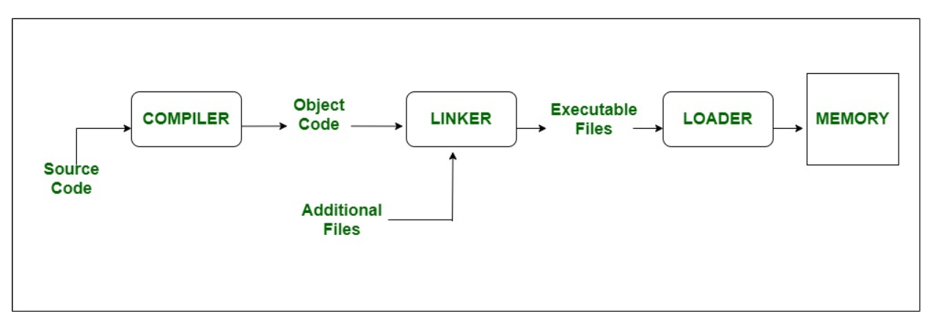
.

Slide 11
Header Files:
Header files also known as include files, or standard library files that have an extension of (.h) and which are used to hold declarations for other files.
e.g: iostream, stdio.h, conio.h iomanip etc.
Reserved Words:
Reserved words or keywords are those words which have their special meaning within the C++ language and are reserved for some specific purpose. C++ reserved words cannot be used for any other purpose in a C++ program and even cannot be used as variable. Here some C++ keywords are as follows:
bool, int, if, for, static, case, break, inline, public, void, goto, short, new, else, friend, catch, switch, while, do-while, namespace etc.

Slide 12
Structure of a C++ program
General syntax of a C++ program is given below.
preprocessor directives <header file>
int main()
{
body of the program
}
Each C++ program has three main components. These are: Preprocessor directives, main function and body of the main function.

Slide 13
1. Preprocessor directives (#include, #defines)
A preprocessor is a collection of special statements which are executed before the compilation process.
Every C++ program contains a preprocessor directives. The #include preprocessor directives is commonly used to insert header files. #include<iostream> is used for the C++ objects cin and cout.
while #include<conio.h> is used for the built-in function getch().
In C++, the other commonly used preprocessor directive is #define which is used to define symbolic constants. Its general syntax is:
#define identifier value
For example,
#define PI 3.14159
#define height 5

Slide 14
2. main() function:
The main() function is the point by where all C++ program start their execution. It does not matter whether whether there are other functions with other names defined before or after it. The instructions contained within this function’s definition will always be the first ones. It executed in any C++ program. For that same reason, it is essential that all C++ programs have a main function.
3. Body of the main() function:
After the parentheses of the main function, the body of main function starts which enclosed in braces { }. When this function is executed, the instructions written within main perform their task. Inside the body of main function, C++ statements are written.

